Slide 1
DATA SCIENCE FINAL PROJECT
CUSTOMER MASS FORECAST IN THE BANKING INDUSTRY

Slide 2
Our Process
Feature Engineering
Best Model Selection for the Target Audience
Data Analysis
STEP 02
STEP 04
STEP 01
STEP 03
STEP 05
Modelling
Feature Selection

Slide 3
CONTENTS
01
02
03
AIM
PROBLEM & SOLUTION
OUR PROCESS
Which customers can have net sales of more than 5 million TL? How can we predict this and introduce the new product with the best model by looking at the customer's data?
To identify customers who can enter this audience in order to present the new product to customers with annual net sales of more than 5 million TL.
To determine which customer's net sales exceed 5 million TL by correlating data and establishing the best model.

Slide 4
OUR PROJECT
The bank develops a new product for commercial customers. As a result of the studies, customers with annual net sales of more than 5 million TL are considered to be the most suitable audience to offer this new product. For this reason, we aimed to establish the best model and estimate the target audience by examining the statistical relationships between them by obtaining new variables with the information of customers with incomplete financial information and 10 variables consisting of 11 K records.

Slide 5
UNDERSTAND THE PROBLEM
MISSING VALUES
DATA ASSOCIATION
Not every company has current financial statements. Without financial statements, we would not be able to obtain appropriate net sales information for customers. We want to make sure we reach all the targeted customers. Therefore, we have to find a way to decide which of these non-financial customers has net sales of more than TL
5 million.
If the total loan balance of the customers in the banking sector is over 5 million TL, can their net sales also exceed 5 million TL?

Slide 6
OUR SOLUTION
DATA ANALYSIS
MODELLING
FEAUTURE SELECTION
FEATURE ENGINEERING
DECIDING THE BEST MODEL AND DETERMINING THE TARGET AUDIENCE
By examining the data, it is decided what should be done on the data.
The best parameters for each model are determined and the results are compared.
✄
After looking at the relational analyses, new variables that can affect the model are derived.
Selection of the variable that most influences the target variable
The model that gives the best result is selected and the final model is created and the target audience is estimated.

Slide 7
DATA ANALYSIS
01
Explanatory data analysis and examination of variables

Slide 8
TARGET and VARIABLES
Sales
Sector
RETAIL-WHOLESALE
51%
MANUFACTURING
26%
OTHERS
16%
SERVICES
8%
13%
1(Sales > 5 million)
10,000+
Transaction Record
25%
3(Sales information is blank.)
62%
0(Sales =< 5 million)

Slide 9
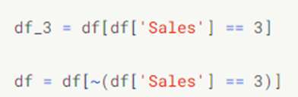
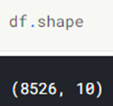
EDA(Exploratory Data Analysis)
→ Since the sales information is not known, we first removed the blank ones from the data.
Data information after removing the non-sales information
After removing the records with empty sales information, when we look at the ratio of values with 0 sales information, we see that it is 83%, and the ratio of those with 1 is 17%. From this, we understand that your data has an unstable data structure.

Slide 10
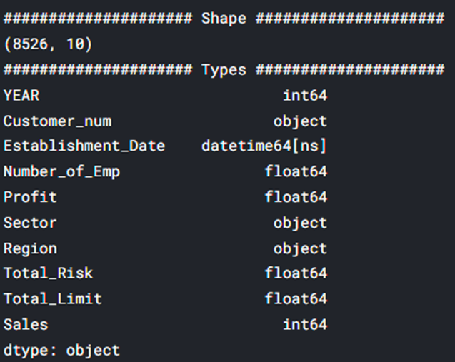
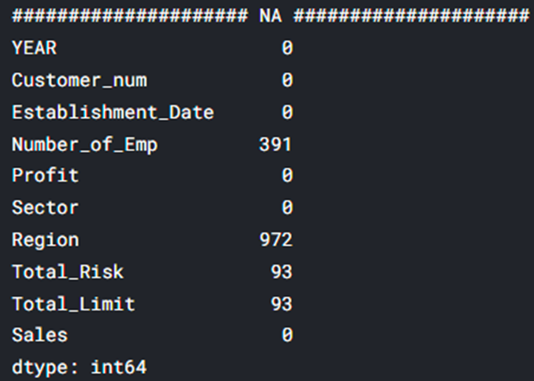
EDA(Exploratory Data Analysis)
According to the analysis made, the results of our data

Slide 11
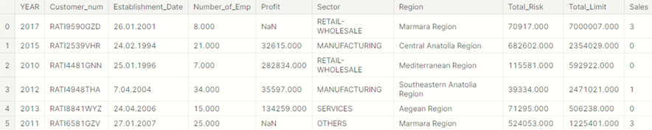
EDA(Exploratory Data Analysis)
According to the analysis made, the results of our data

Slide 12
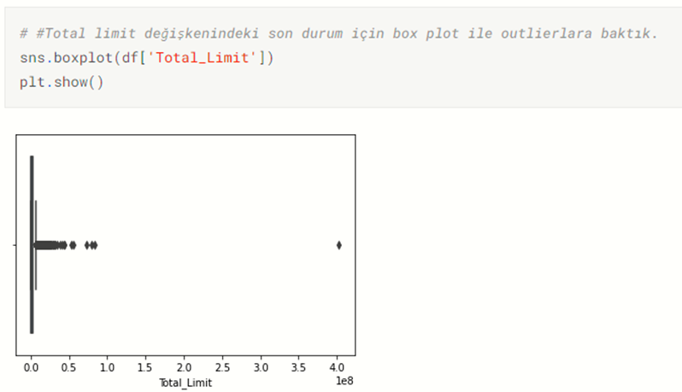
EDA(Exploratory Data Analysis)
Box Plot Charts of Variables

Slide 13
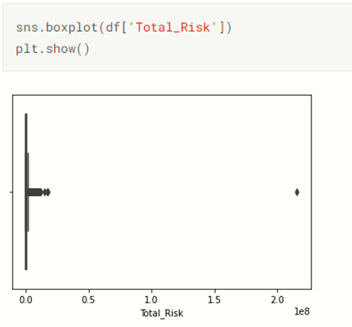
EDA(Exploratory Data Analysis)
Box Plot Charts of Variables

Slide 14
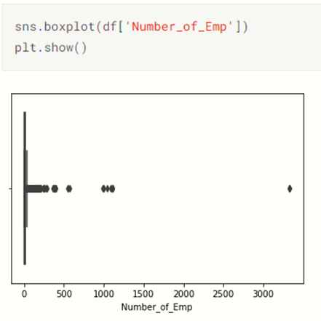
EDA(Exploratory Data Analysis)
Box Plot Charts of Variables

Slide 15
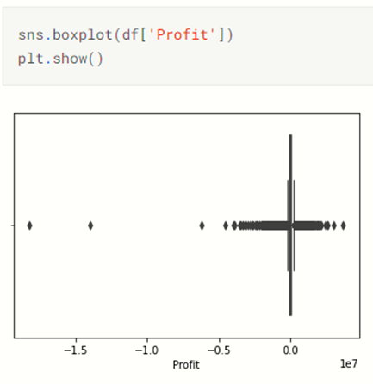
EDA(Exploratory Data Analysis)
Box Plot Charts of Variables

Slide 16
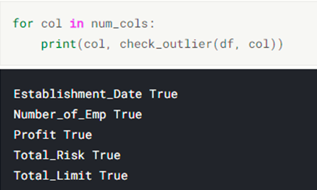
EDA(Exploratory Data Analysis)
Outlier Analysis

Slide 17
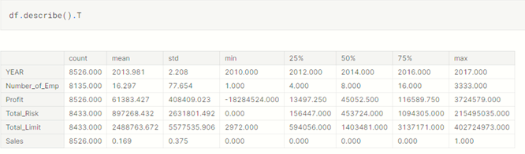
EDA(Exploratory Data Analysis)
Definition of Data

Slide 18
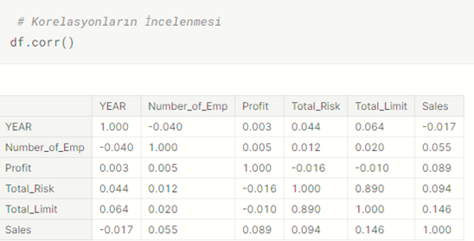
EDA(Exploratory Data Analysis)
Correlation Analysis Between Variables of Raw Data
When we look at the correlation analysis, we see that the independent variable that most affects the target variable is the total limit, total risk, profit and number of employees.
When we looked at the correlation between independent variables, we saw that the variables with the highest correlation were total limit and total risk.

Slide 19
MODELLING
02
Establishing the base model as the first step, then obtaining the best model score

Slide 20
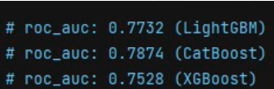
Creating the Base Model
→ Without creating all the new variables, we calculated how many years ago he contacted the bank by simply subtracting the date from the year information and added it to the data set.
→ For categorical variables, we encoded our data with one hot encoder.
→ We split our data as a train test and got our first results by inserting it into the models.

Slide 21
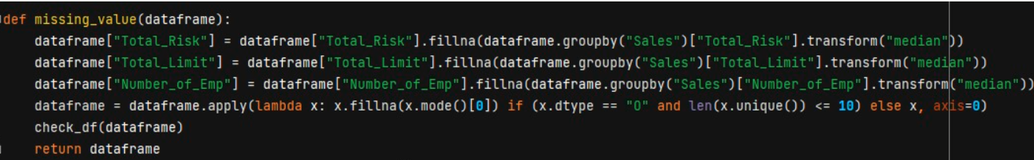
FILLING IN MISSING VALUES
In order to run all models, we first fill in the missing values.
For the region variable, we filled in the missing values according to the mode of the sales variable.

Slide 22
FEATURE ENGINEERING
03
Generating new variables that can affect the target variable

Slide 23
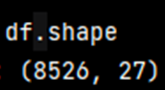
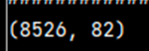
FEATURE ENGINEERING
Based on the correlation analysis we made, a total of 27 variables were derived after feature engineering.
→ We encode the data again with one hot encoder.

Slide 24
Robust Scaler
We used robust scale because it scales by quarters and there are many outliers in our data. When we run the model without scaling first and then scale it, when we look at the results, we saw that it did not affect the outliers, but it did affect the speed of the model.

Slide 25
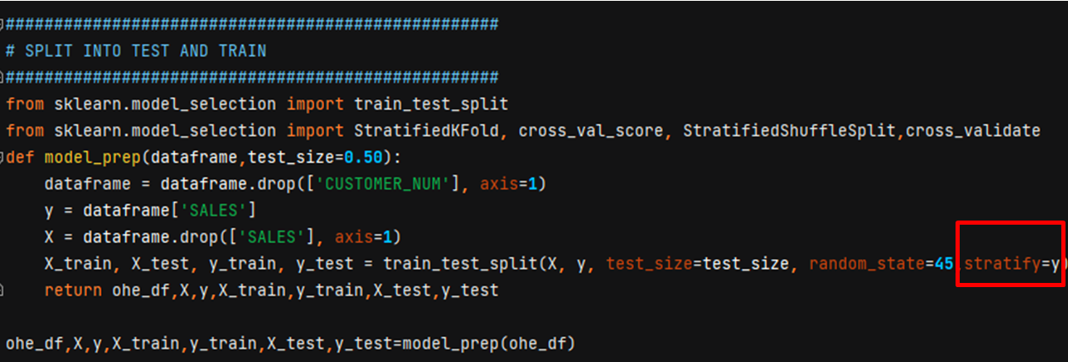
Creating a Test-Train Set
→ Since our data is unbalanced, we used this method to divide the data homogeneously.

Slide 26
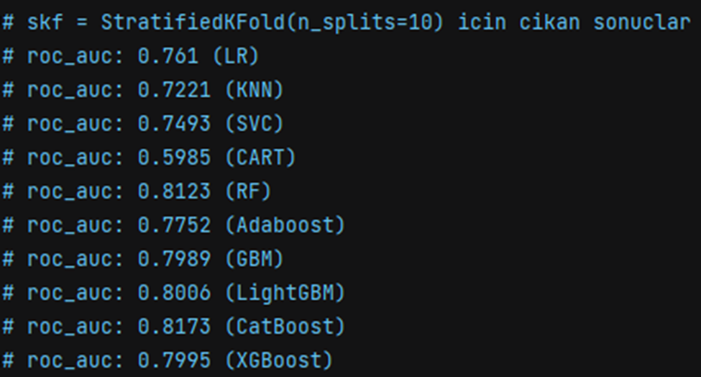
Base Model Comparison
Outliers
→ When we removed outliers from the data, we observed that it did not affect the success of the model, and for this reason, we found it appropriate to leave the outliers in the data.

Slide 27
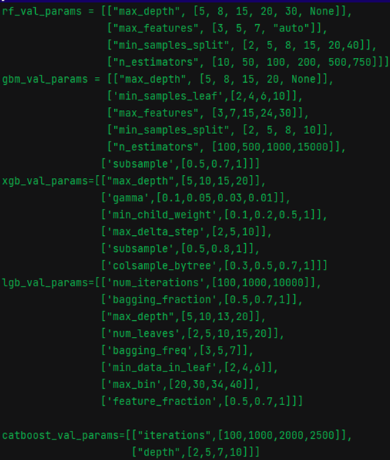
Hyperparameter Optimization
In the light of base models and newly created variables, the hyperparameters of the first 5 models that gave the best AUC value were extracted.
Notes:
Grid search ve Random search ile elde edilen sonuçların çıktısını almak uzun sürdüğünden dolayı ilk önce küçük değerler verildi, ardından aralıklar değiştirilerek yeni değerler denendi.

Slide 28
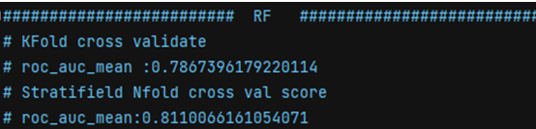
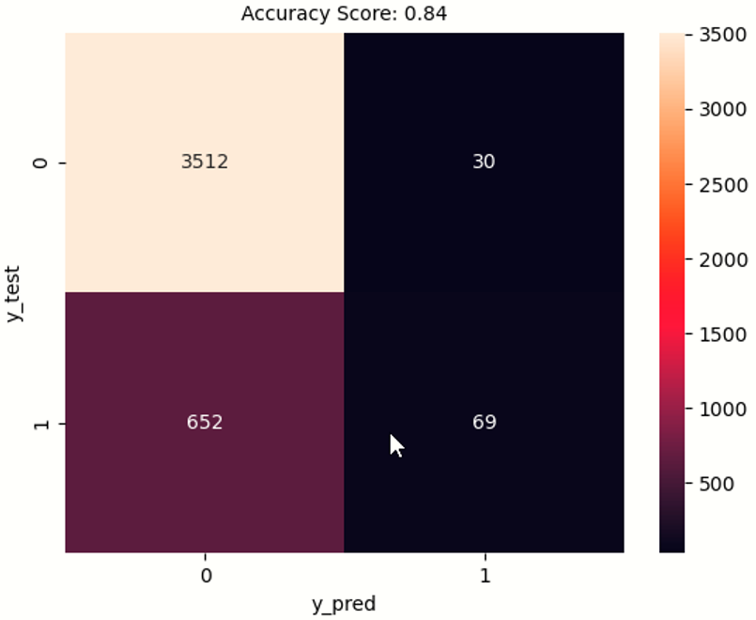
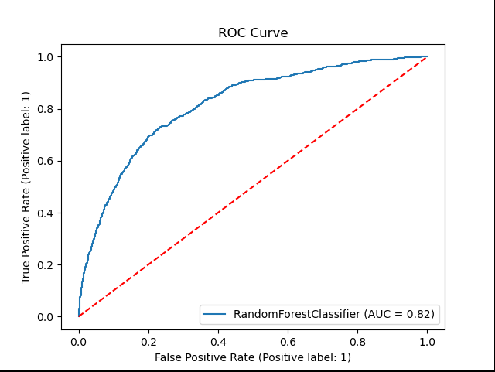
Random Forest Model

Slide 29
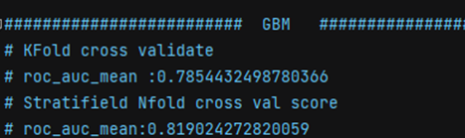
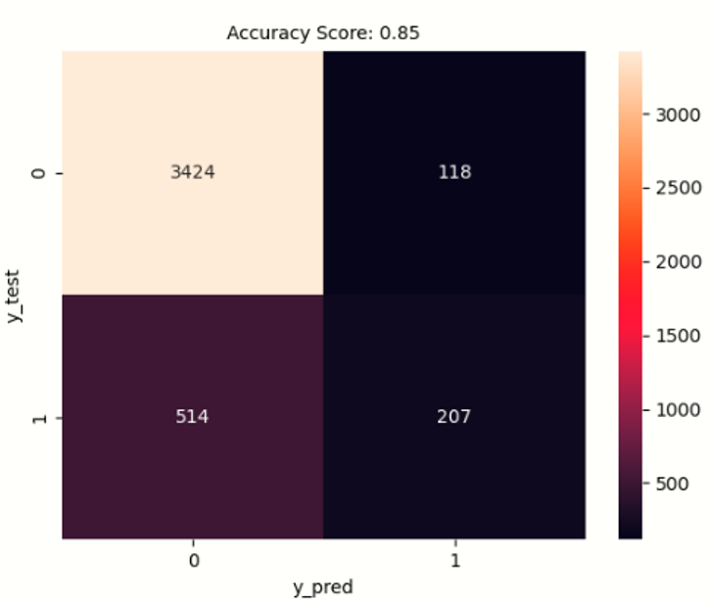
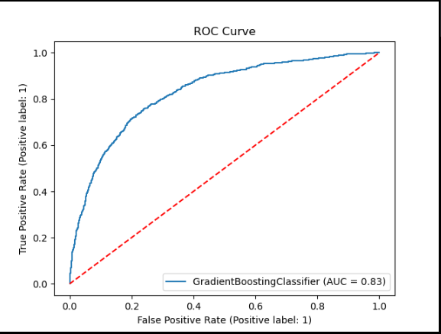
Gradient Boosting Model

Slide 30
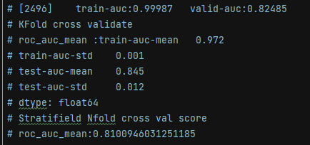
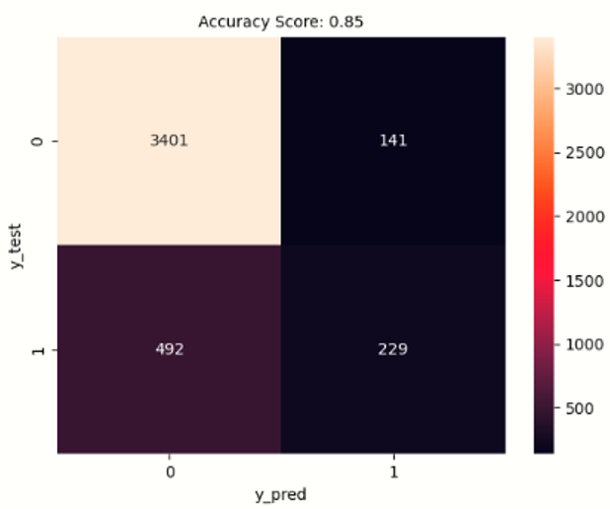
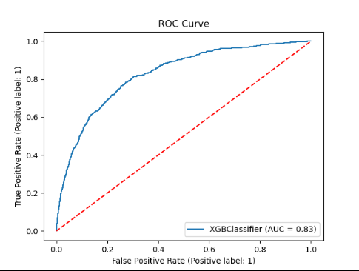
XGBoost Model

Slide 31
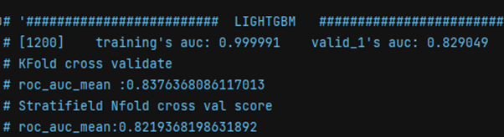
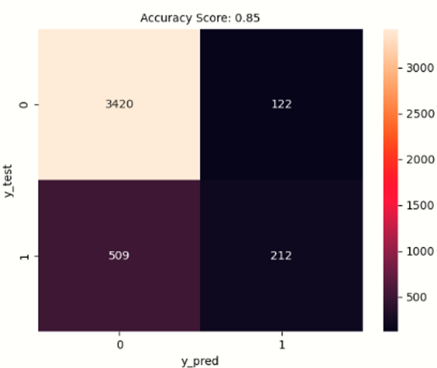
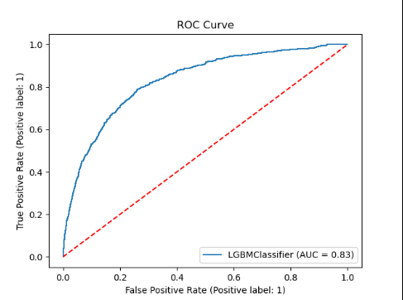
Light GBM Model

Slide 32
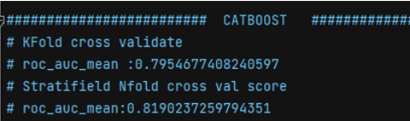
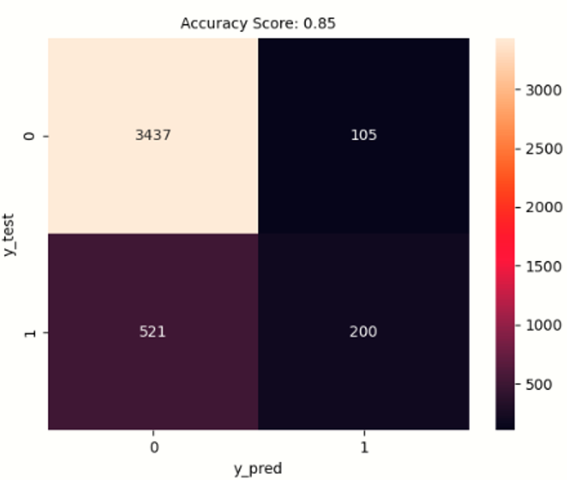
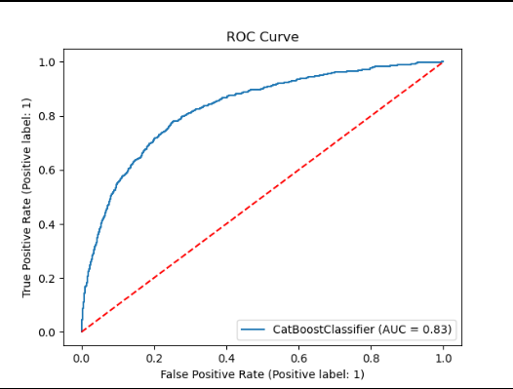
CatBoost Model

Slide 33
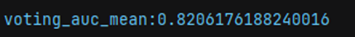
Stacking Ensemble Learning
As a result of hyper parameter optimization, a vote is made between the algorithms that give the best AUC value.
A vote is made according to each model, and as a result, the voting value is 82%. So we got an average result close to our models.

Slide 34
FEAUTURE SELECTION
04
Model complexity removal

Slide 35
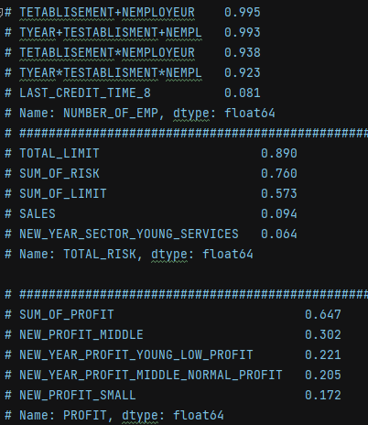
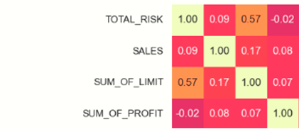
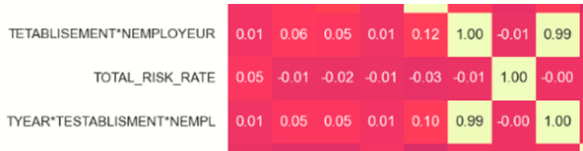
CORRELATION MATRIX

Slide 36
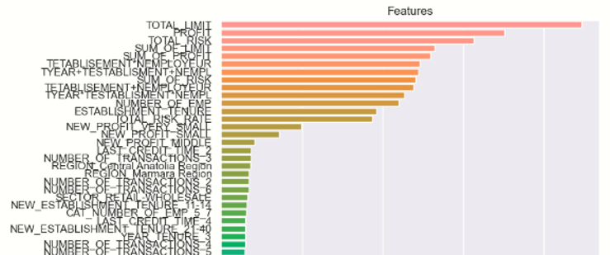
FEAUTURE IMPORTANCE
RF FEAUTURE IMPORTANCE

Slide 37
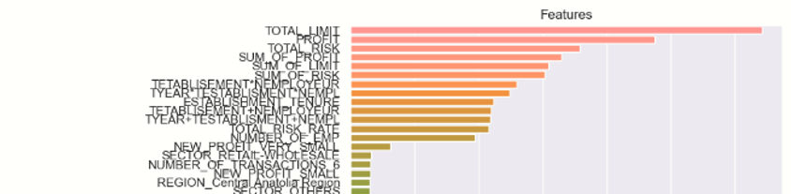
FEAUTURE IMPORTANCE
GBM FEAUTURE IMPORTANCE

Slide 38
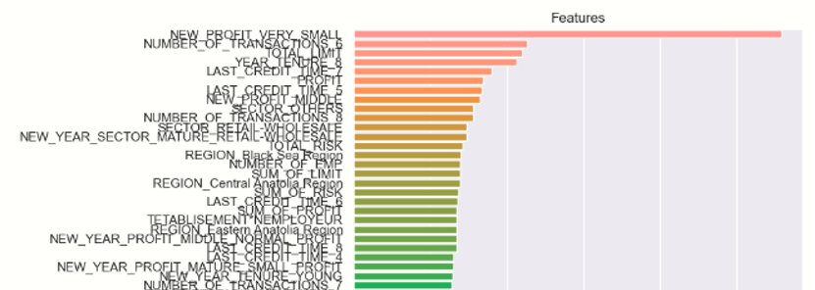
FEAUTURE IMPORTANCE
XGBOOST FEAUTURE IMPORTANCE

Slide 39
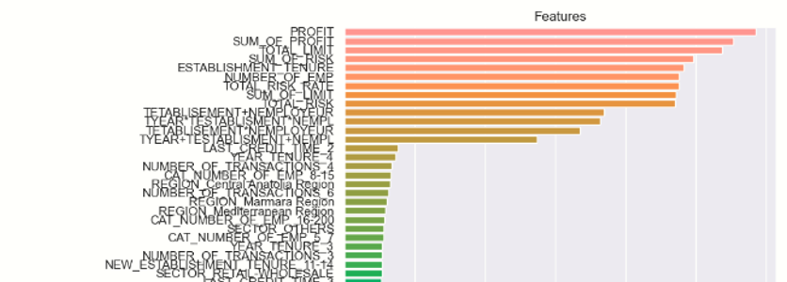
FEAUTURE IMPORTANCE
LİGHTGBM FEAUTURE IMPORTANCE

Slide 40
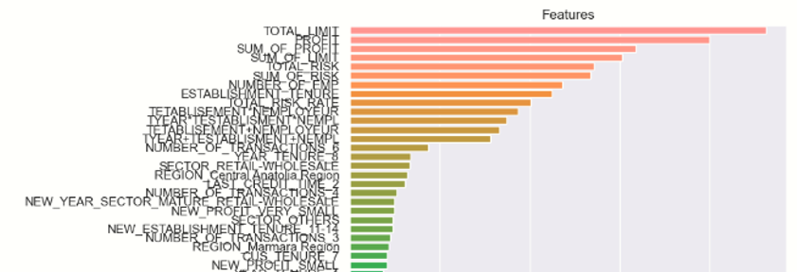
FEAUTURE IMPORTANCE
CATBOOST FEAUTURE IMPORTANCE

Slide 41
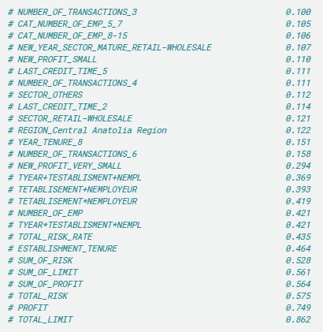
FEAUTURE IMPORTANCE
We will look at the average of feature importance of all models and make feature selection.
→ By looking at the correlations and feature importance, some of the features with high correlation and low importance were removed from the data.

Slide 42
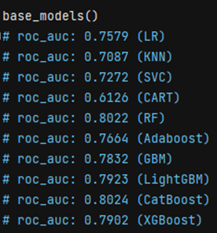
Comparison of Models
A new base model was established with the remaining variables after the values extracted from the data.

Slide 43
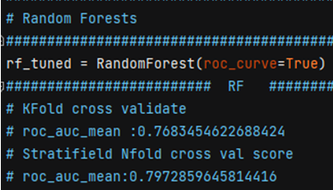
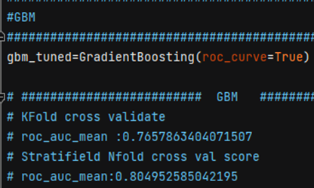
Comparison of Models
Random Forest
Gradient Boosting

Slide 44
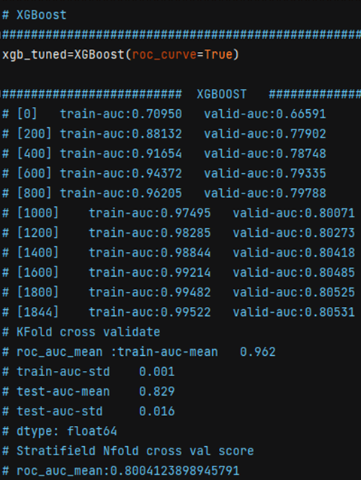
Comparison of Models
XGBoost

Slide 45
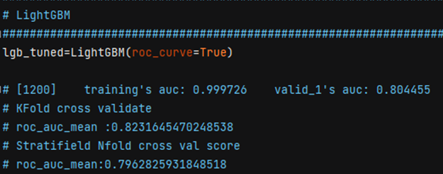
Comparison of Models
LightGBM

Slide 46
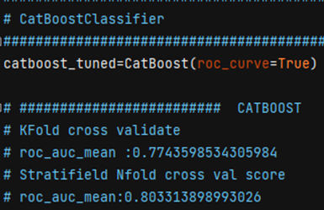
Comparison of Models
CatBoost

Slide 47

Stacking Ensemble Learning
As a result of all models, we do the voting again and we get a result of 80%.

Slide 48
FİNAL MODEL
05
Deciding on the best model

Slide 49
Selecting the Final Model
Among the models, LIGHTGBM and XGBOOST give the best results, so you can choose between the two.
We chose this model as the final model because XGBOOST was a little more successful than other models.
→ Finally, we pipelined all the operations and turned them into a pickle file.

Slide 50
RESULTS
 | AUC Score | Explanation
Base Model | %78 | The result we obtained after the first models were established after the EDA
Filling Missing Values & Feature Engineering | %84 | Best result after filling in missing values and creating new variables
Feauture Selection | %82 | The result obtained after the selection of the variables that have the best effect on the target variable
Best Model | %84 | The result we got with XGBoost, which is the best model as a result of hyper parameter optimization

Slide 51
%84
FİNAL AUC SCORE
As a result of our final model, XGBOOST, we can predict the target audience 84% accurately according to the AUC score.

Slide 52
FUTURE PLANS
F1 SCORE
AUC SCORE
%30
%84
In the next stage, we will try to increase the F1 score on unbalanced data.
Our F1 score was low due to unstable data problem. For this reason, we aim to increase the F1 score.
As a result of the best model, our AUC score is 84%.

Slide 53
THANKS
BAHA ULUǦ
linkedin.com/in/baha-ulug
ELİF ÖZDEMİR
linkedin.com/in/elif-özdemir-8892729b
ESRİN ERDEM
linkedin.com/in/esrin-erdem-3677161a4
İSMAİL HAKKI ÖZÇELİK
linkedin.com/in/ismail-ozcelik
ESRA BARBAROS
esrabarbaros@gmail.com

